Slide 1
Weekly Project Update
Abdellah Sabhi
Laurent Bialylew

Slide 2
Work done this week
01
02
03
Updated UMLs
Added bulk add function
Updated use case diagram
Added a bulk add function allow a list of books to be added at once
Added bulk delete function
Added bulk delete function to delete a list on books based on some attributes

Slide 3
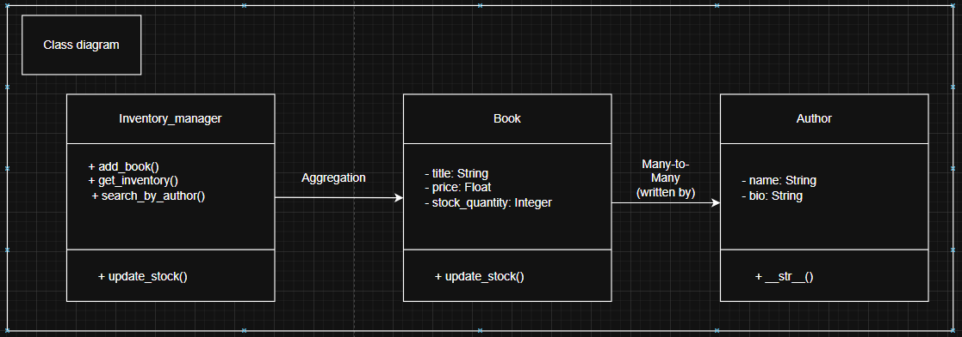
Class UML

Slide 4
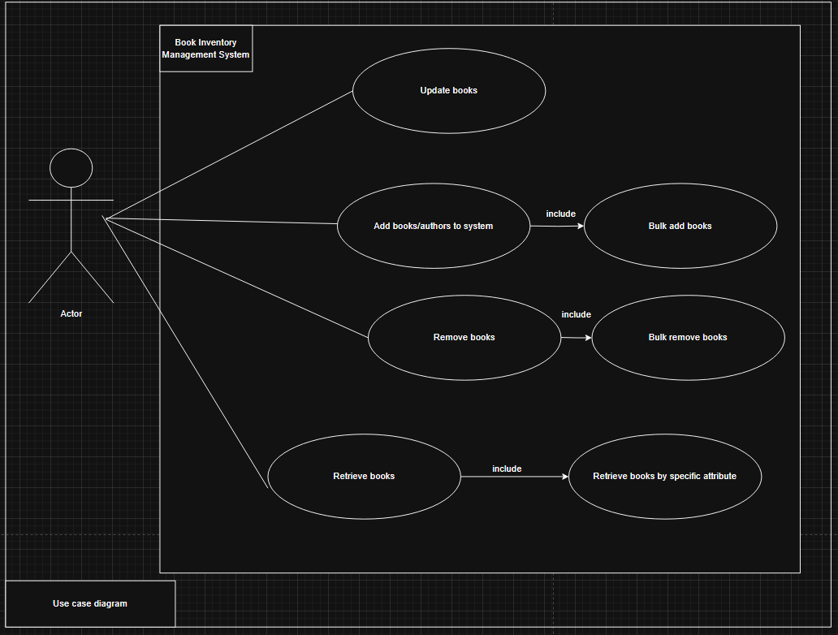
Use case UML

Slide 5
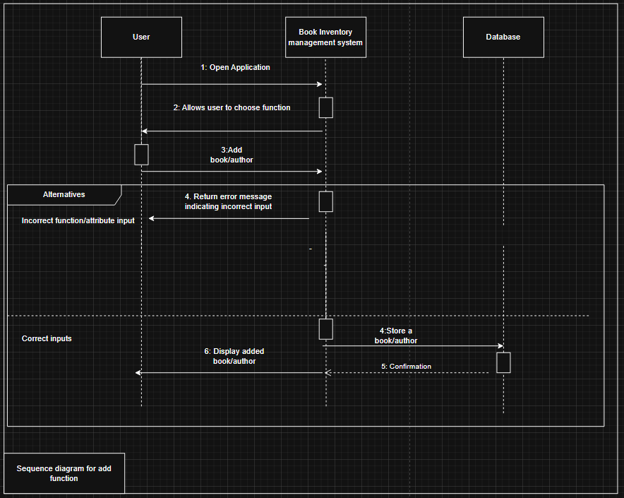
Sequence UML for add function

Slide 6
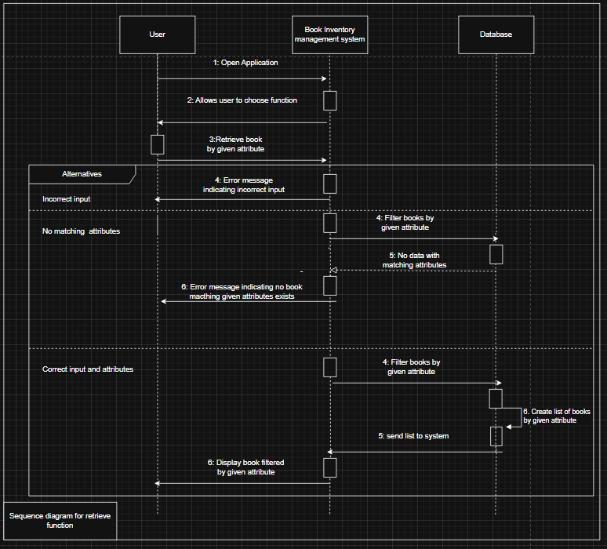
Sequence UML for retrieve function

Slide 7
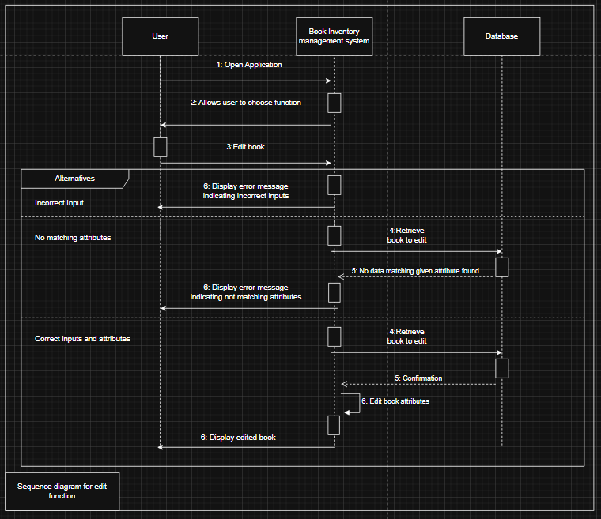
Sequence UML for update function

Slide 8
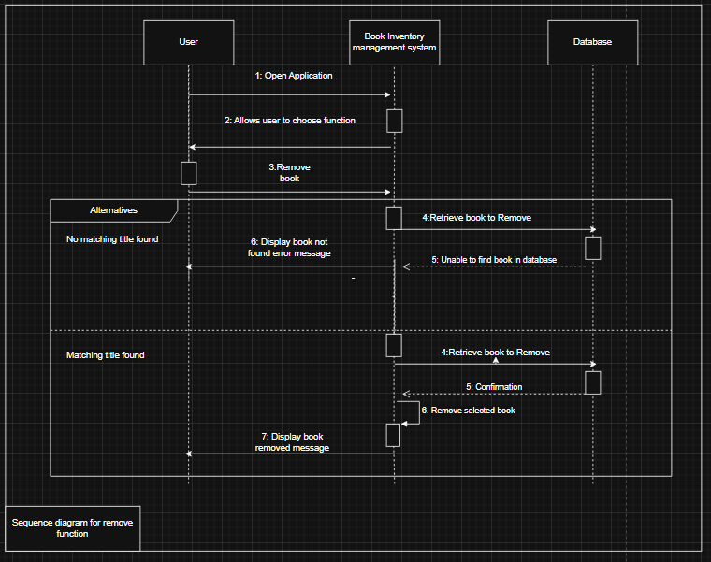
Sequence UML for remove function

